Slide 1
Diving deeper
Website: Day 2

Slide 2
Features section

Slide 3
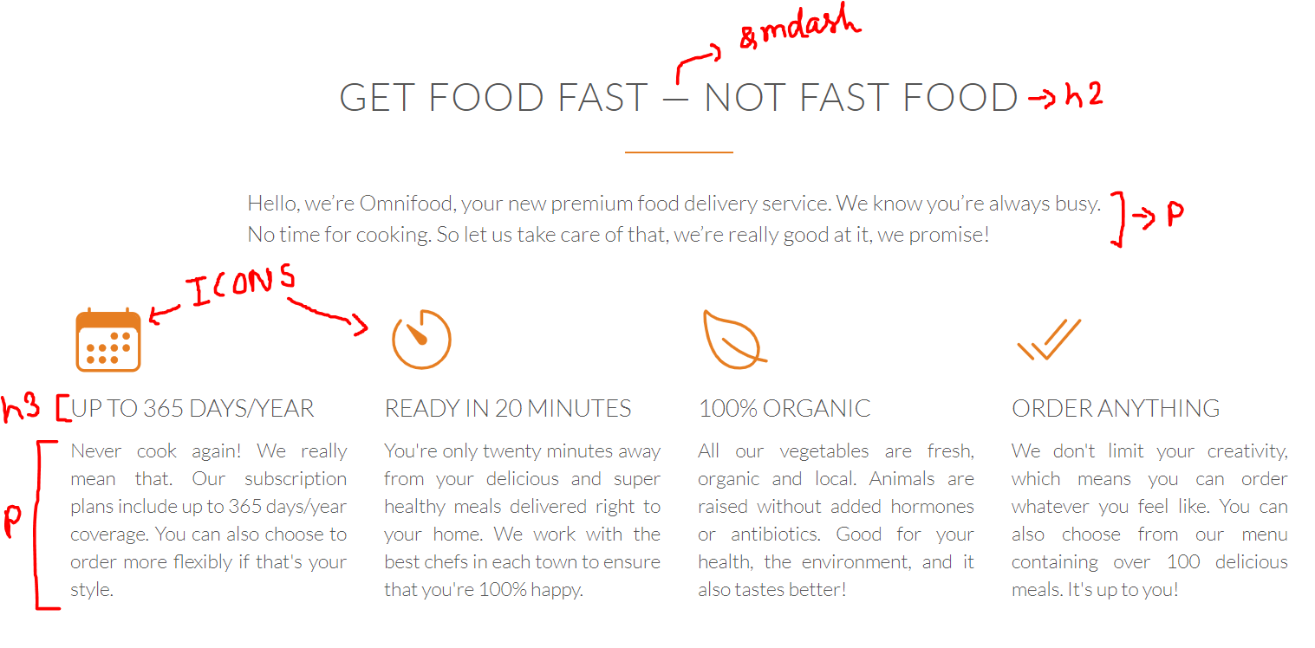
Features section

Slide 4
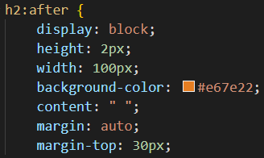
Features section
To display the character —, you can use its HTML entity &mdash.
You can implement the small orange dash after the h2 tag your way.
It can be a div of fixed height and width and color. Or you can do this -
Content: empty whatever we write it will show

Slide 5
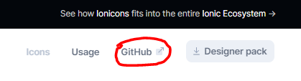
Icons
Structuring the whole thing with flexboxes should be easy. So you can go ahead and do that now. In place of the icons, you can keep an empty div for now.
When done, let’s add some icons. We will use ionicons for this. It’s very useful and easy to use.
Click here to view its github page and read the documentation

Slide 6
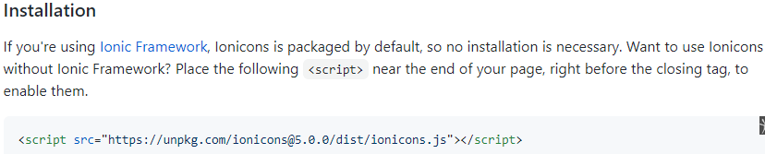
Icons
Read the installation and using guide

Slide 7
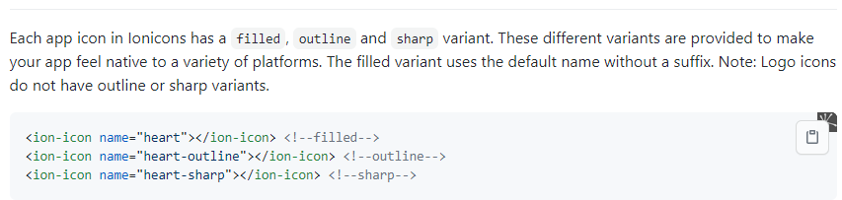
Icons
Usage

Slide 8
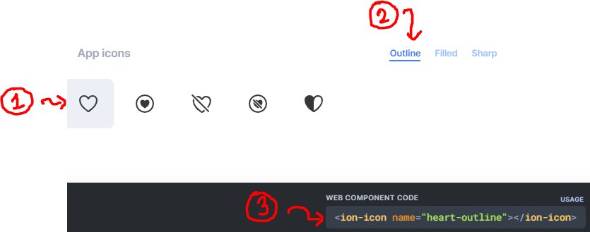
Icons
Search and choose icon
Choose variant
3. Copy and the paste code
Stroke width = inner lines/outline
Thickness
Icon = calendar, leave, tick,

Slide 9
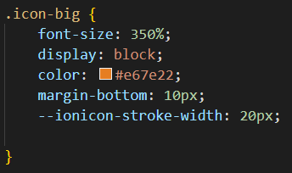
Icons
You can apply CSS to it like any other HTML element
What does the last line do? LOOK IT UP! (in ion icon documentation)

Slide 10
Favourite meals section

Slide 11
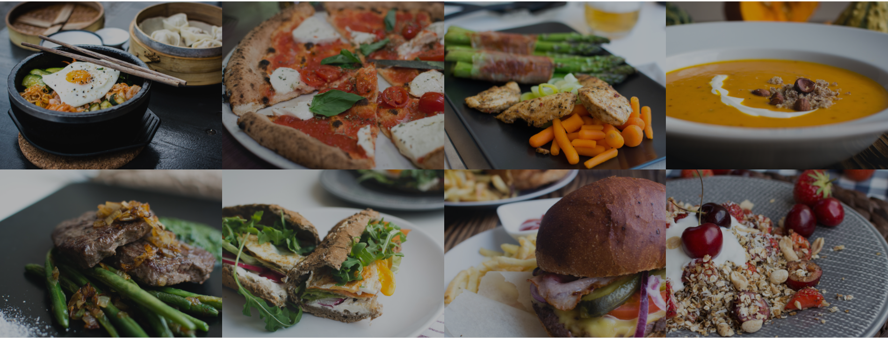
Favourite meals
You can apply CSS to it like any other HTML element

Slide 12
Favourite meals
This section spans through the whole horizontal space.
You already know how to stack things up in grid as shown here. But that’s not all. Notice that the images get brighter and “zoomed out” when you hover over them.
To achieve the “brighter” effect, set the images to an opacity of 0.7, and the background color of their parent container to black. This will keep them darker by default.
On hover, set their opacity to 1.

Slide 13
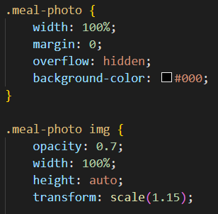

Favourite meals
Overflow is used when using floats
For the “zoom” effect, set the scale to 1.15 to default, and scale to 1 on hover.
.meal-photo applies to the parent container
.meal-photo img applies to the images inside the parent container

Slide 14
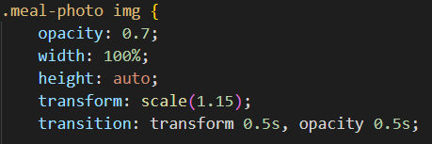
Favourite meals
But the transition seems too rapid. Notice how the change takes place slowly in the website.
We want any changes in the properties transform and opacity to take 0.5 seconds. This is how you do it -
Note: You should always add transition to the default state, NOT in :hover pseudo-class

Slide 15
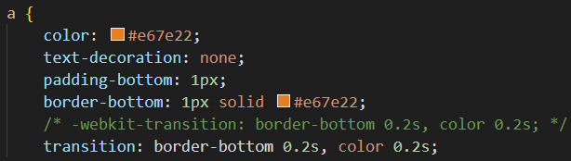
Favourite meals
Now use transition to slow the color and border change of all anchor tags on the website.
As a general rule of thumb, you might want to use transitions whenever you find yourself using pseudo-classes like we do with anchor tags.
Ex -

Slide 16
Finish designing these sections

